Slide 1
BINARY ROAD WHEEL ALIGNMENT CLASSIFICATION USING MACHINE LEARNING
Collaboration between Chassis Controls and Research & Adv. Engineering
Devon Eyerman
Joshua McCready

Slide 2
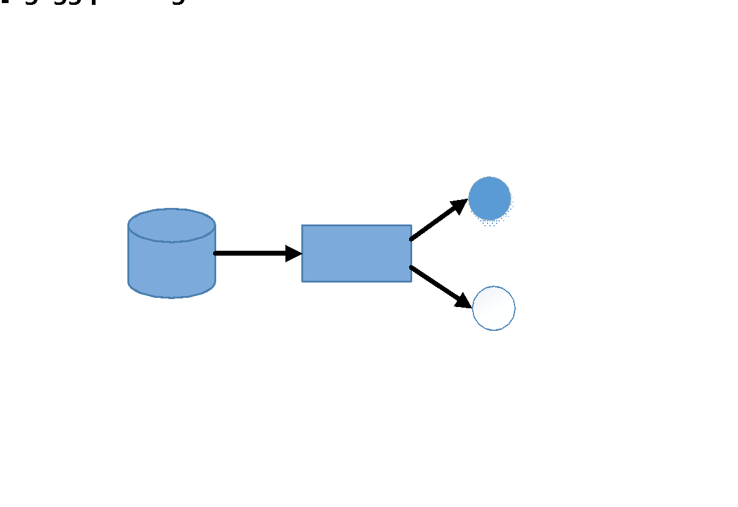
EXPERIMENT BACKGROUND AND PROBLEM
Background: ‘17 Ford Fusion was instrumented to collect vehicle signals buses and internal control module signals as part of AV Diagnostics Development
Experiment consisted of modifying vehicle alignment, tires, tire pressures, and weighting conditions and driving it over the course of 1 year
Generated ~40 GB of recorded signals
Data format required significant modification to be used in Machine Learning
Challenge: Using collected data, identify misalignment of the road wheels as binary classification with supervised pattern recognition techniques in the presence of nominal operation and noise factors in the experiment data
Purpose: Reduce warranty cost and increase customer satisfaction/UX by detection + warning of road wheel misalignment before tire damage
Factor | Condition | Population Affected (%)
Left Tire Pressure | Nominal | 37.7
 | 28 | 18.4
 | 36 | 15.4
 | 41 | 0.7
 | 42 | 21.1
Right Tire Pressure | Nominal | 37.7
 | 20 | 0.1
 | 25 | 0.1
 | 28 | 23.3
 | 30 | 0.1
 | 31 | 0.2
 | 34 | 17
 | 35 | 0.6
 | 41 | 0.8
 | 42 | 20.1
Tire Condition | Conicity Left | 26.6 (summed)
 | Conicity Right
 | Bad | 16.4
 | Good | 57
Alignment Bias | Left | 35.6
 | Right | 27.7
 | Misaligned (Unspecified) | 1.5
 | Nominal | 35.2
Vehicle Loading | GVWR Left | 0
 | GVWR Right | 26.2
 | GVWR Center | 19.1
 | 1UP | 54.7

Slide 3
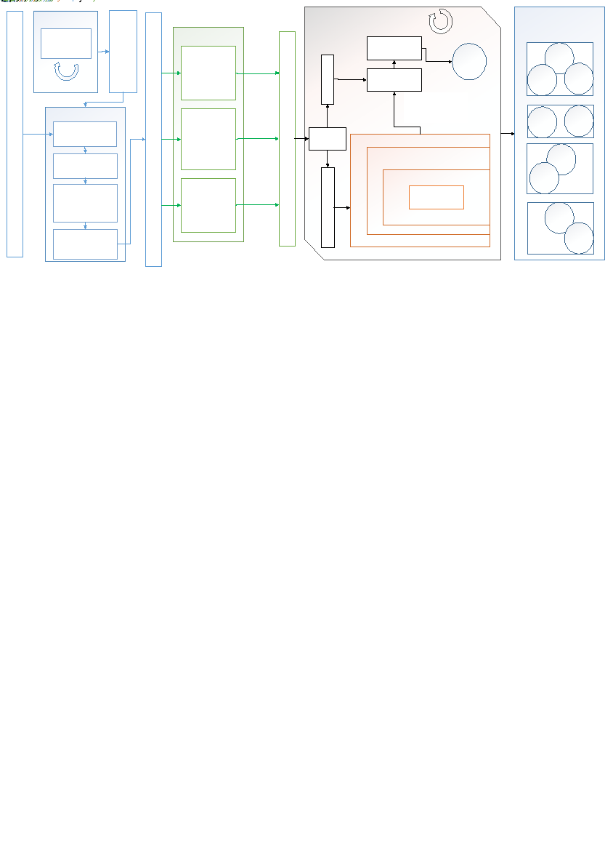
MISALIGNMENT CLASSIFICATION CHALLENGE EXPANDED
Question 1: How are signals related and what signals should be used to most effectively predict alignment condition with the lowest complexity?
Question 2: What combination of supervised classiﬁcation machine learning techniques will effectively predict misalignment in the presence of noise factors?
Question 3: How do the “Best Models” of several classification techniques compare, and how can ensembles of these models improve performance?
Above is a diagram explaining the overall outline of the experiment that answers the challenge questions

Slide 4
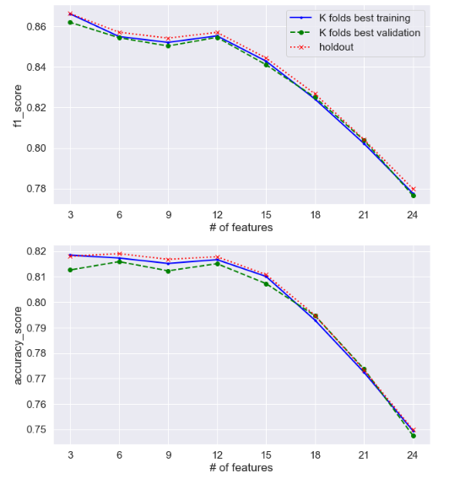
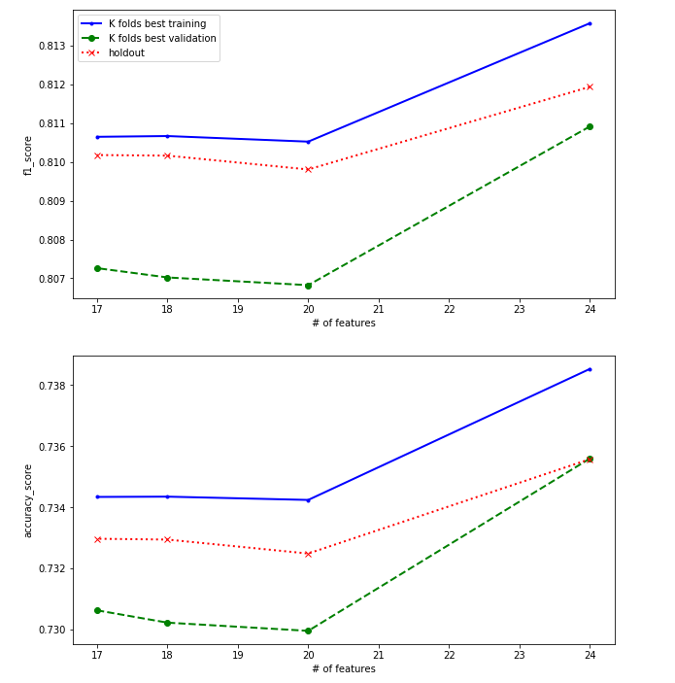
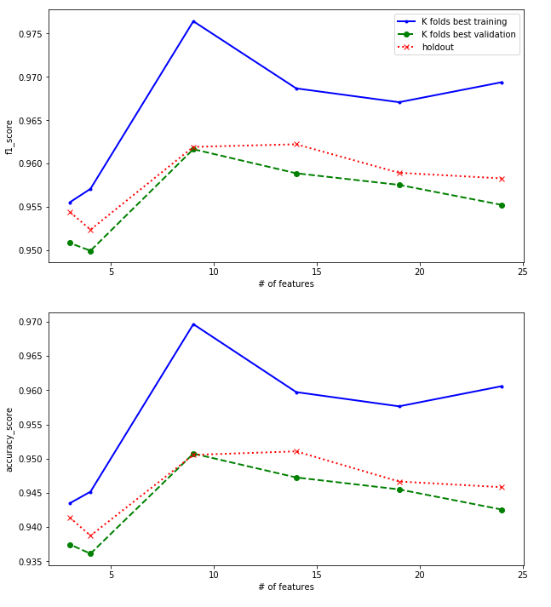
ITERATIVE MODEL IMPROVEMENT
Experiments in Python were performed to answer what models, signals, and model parameters best predicted misalignment. The experiments were performed according to the outline of the experiment. An overview of the grid search hyper-parameters and feature elimination methods is provided.
Best models were selected by the highest K^{th} fold Training set’s ‘f1’ score.
See the performance of the resultant models below:
Binary Classifier | Hyper Parameter Grid Search Space | Feature Elimination Method
Naïve Bayes | None | Eliminate n Signals with lowest rank according to mutual information scores
Logistic Regression | a) Regularization: {’none’, ’l1’,’l2’, ’elasticnet’} | Choose best elastic net model from grid search and remove an near 0 weighted features
 | b) Regularization Coeff. (λ): {0.01, 0.25, 0.5, 1, 5}
 | c) Elastic Net Mix Coeff. (α): {0.1, 0.5, 0.9}
Multilayer Perceptron (Fully Connected NN) | a) Hidden Layer Sizes: {(5,), (10,) , (30,), (60,), (90,), (30,5,)} | Eliminate n Signals with lowest rank according to Feature-based Sensitivity of Posterior Probabilities
 | b) Regularization Coeff.: {0.0, 0.001, 0.1, 1, 10}
Naïve Bayes
Logistic Regression
Multilayer Perceptron

Slide 5
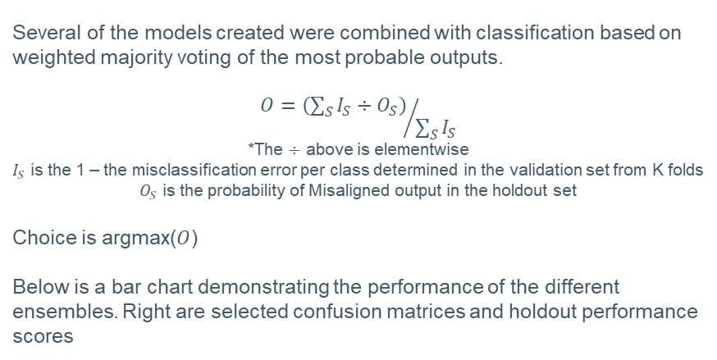
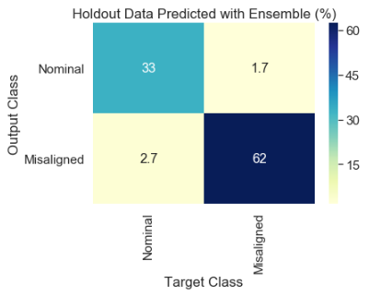
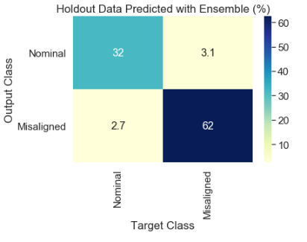
MODEL ENSEMBLE PERFORMANCE
MLP1 + MLP2 + MLP3 : Holdout set performance:
Accuracy: 0.96
F1 Score: 0.97
Recall: 0.97
Precision: 0.96
Best performance, MLP1, MLP2, MLP3 are first 3 lowest number of features
NB + LR + MLP1: Holdout set performance:
Accuracy: 0.94
F1 Score: 0.96
Recall: 0.95
Precision: 0.96
Most performance gains come from inclusion of MLP
NB – Naïve Bayes, LR – Logistic Regression, MLP – Multilayer Perceptron

Slide 6
INTERPRETATION OF RESULTS
Naïve Bayes shows that reasonable performance is achieved with low complexity on a simple model using measures of:
Logistic Regression models did not achieve good performance to a heuristic low # of inputs and good f1 score, nor did performance improve greatly over iterations in our experiment
Multilayer Perceptron models achieved the best performance against heuristic at the cost of computational complexity using measures of:
Simplest of MLPs tried used only measures of assist torque and steering wheel angle and achieved good performance
Assist torque
Steering wheel angle offset
Vehicle speed
Assist torque
Input torque
Steering wheel angle offset
Vehicle speed
Longitudinal acceleration
Front wheel speed difference
Best ensemble model of 3 MLP models achieves 1.7% false positive rate without from raw signal values.
We can learn what’s important in the input signals for classification from model parameters from training – like a secondary exploratory data analysis
All signals had limited ability to predict output based on their mutual information scores, but together they can predict well without any feature engineering.
Feature engineering may be able to improve performance and/or reduce complexity

Slide 7

QUANTIFIED BENEFITS
Michelin: “Early tire removal wastes $25 billion each year, and 400 million wasted tires per year go to landfill, the equivalent of 35 million tons of carbon dioxide emissions.” See .pdf for source.
Improper tire wear due to wheel misalignment in passenger vehicles results in negative side effects for customers, Ford and the environment. Reducing premature wear can improve user experience, reduce Ford’s landfill contribution, reduce carbon emissions, and save money.
User experience:
Imagine visiting a Ford dealership for routine service where you learn that your tires are worn due to a compromised ball joint ($200), an alignment is needed ($150), and your tires need to be replaced ($400). A surprise $750 is not what the customer wants to experience.
Imagine instead seeing this notification: “Your Ford vehicle has detected that your vehicle requires service to avoid uneven tire wear. Would you like to schedule an appointment at a service center?”
Even though both scenarios are costly for the customer, preventing extra expense is preferable.
Warranty Claim Reduction: (Example)
Assume that 1 R/1000 could be prevented if the customer could receive notice of their need for an alignment.
Assume that 70% of customers act on the diagnostic before their tires wear too much and need to be replaced.
Assume that only the front tires wear improperly, and that each tire costs $200 to replace.
Assume 2.5 mil vehicles sold per year.
Possible warranty savings per year: $700,000
Further study is of warranty claims is required to better quantify the warranty impact.

Slide 8
IMPLEMENTATION PLAN
Short Term (1-3 months)
Investigate that models/model topologies can absorb ratio and ordinal features
Perform feature engineering according to the mechanisms available in PARSED spec or other methods
Perform experiments and exploratory data analysis on engineered dataset seeking to improve performance and/or complexity
Study true warranty cost to Ford
Discuss project with more stakeholders
Draft patent/SAE paper with findings
Longer Term (3-6 months)
Study feasibility of topologies for an in-vehicle or online diagnostic with planned FNV2/3 technology
In-vehicle: deployment of successful models and feature engineering to research hardware
Online: Deployment of feature engineering and over the air data collection and deployment of online models for diagnostic
Evaluate stakeholder interest, business case, and possibility for implementation on research fleet.

